Slide 1
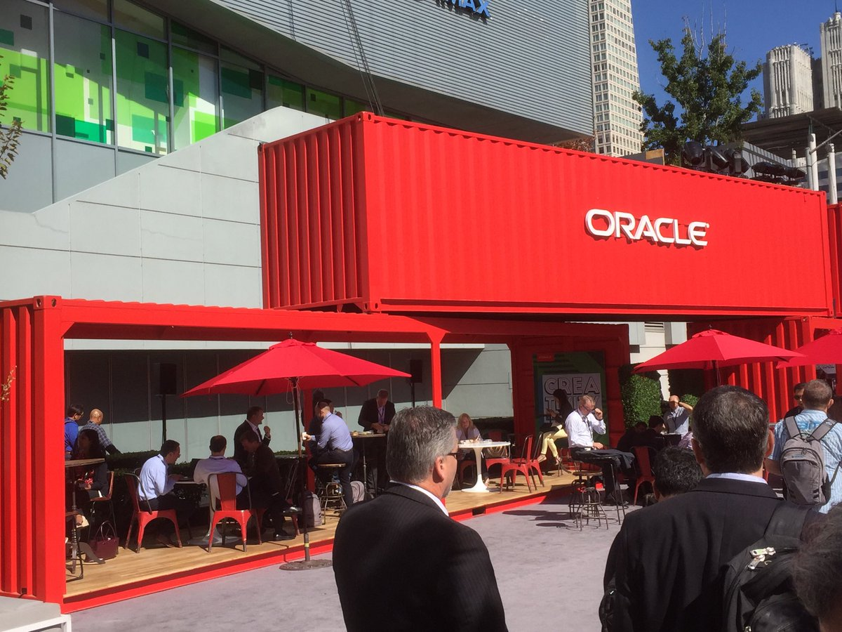
Cloud & Container Native & The application server platform of the future & Serverless FaaS
Oracle OpenWorld 2017 - Review
Cloud & Container Native & The application server platform of the future & Serverless FaaS

Slide 2
What is IT all about?
Production Runtime
Application

Slide 3
What is IT all about?
Production Runtime
Application
Platform

Slide 4
What is IT all about?
Production Runtime
Operations
Monitoring & Management
Application
Platform

Slide 5
One team has Agile responsibility through full lifecyle
Preparation Runtime
Production Runtime
Development
Operations
Monitoring & Management
Application
Application
Agile Design, Build, Test
Platform
Platform
CD

Slide 6
One team has Agile responsibility through full lifecyle
Preparation Runtime
Production Runtime
DevOps
Monitoring & Management
Application
Application
Agile Design, Build, Test
Platform
Platform
CD
You build it, you run it, you fix it, you evolve

Slide 7
One team has Agile responsibility through full lifecyle
DevOps
Application
Application
Platform
Platform
You build it, you run it, you fix it, you evolve

Slide 8
DevOps team owns and runs one (or more) products
Application
Platform
Generic Infrastructure Platform for running DevOps Products
Floorspace, Power, Cooling, Storage, Compute
Monitoring, Management, Cache, Authentication, RDBMS, Event Hub

Slide 9
Multiple products from multiple teams run on a shared generic infrastructure
Application
Application
Application
Application
Application
Platform
Platform
Platform
Platform
Platform
Generic Infrastructure Platform for running DevOps Products
Floorspace, Power, Cooling, Storage, Compute
Monitoring, Management, Cache, Authentication, RDBMS, Event Hub

Slide 10
App plus platform under DevOps == Microservice
µ
µ
µ
µ
µ
Generic Infrastructure Platform for running DevOps Products

Slide 11
App plus platform under DevOps == Microservice
Stateless
Horizontally scalable
Mutually Independent
upgrade, patch, relocate
Can expose Public API (HTTP/REST) and/or UI
Communicate with each other through events
Have their own bounded data context
Do not rely on other microservices [for the data they need]
Serverless – do not require allocated server, can be fired up
µ
µ
µ
µ
µ
Generic Infrastructure Platform for running DevOps Products
λ

Slide 12
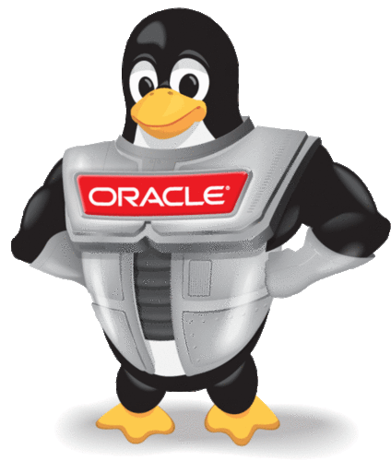
Once upon a time – a container based microservice
http requests
µ

Slide 13
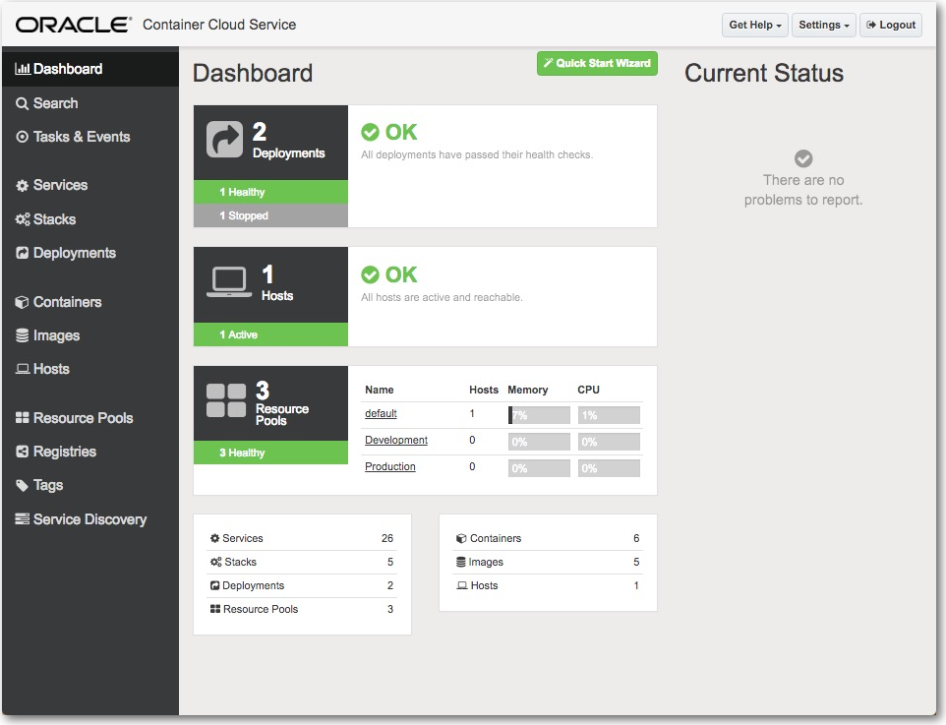
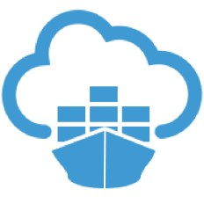
Where is the container running?
Any Docker Host – on premises or cloud based VM - or a Container Cloud Service
For example: Oracle Container Cloud Service
µ

Slide 14
How did the container start running in the runtime?
µ
Through a CI/CD Pipeline
Build process
Take a Basic runtime image – e.g. Linux plus Some Language VM
Add application code
Add runtime agents and tooling
Add platform/runtime configuration
Then Build the Image
Test the Image
Tag and Push Image to Registry
Deploy the image plus applicable configuration to a specific destination container runtime environment
The CI/CD Process is managed manually or triggered by development event

Slide 15
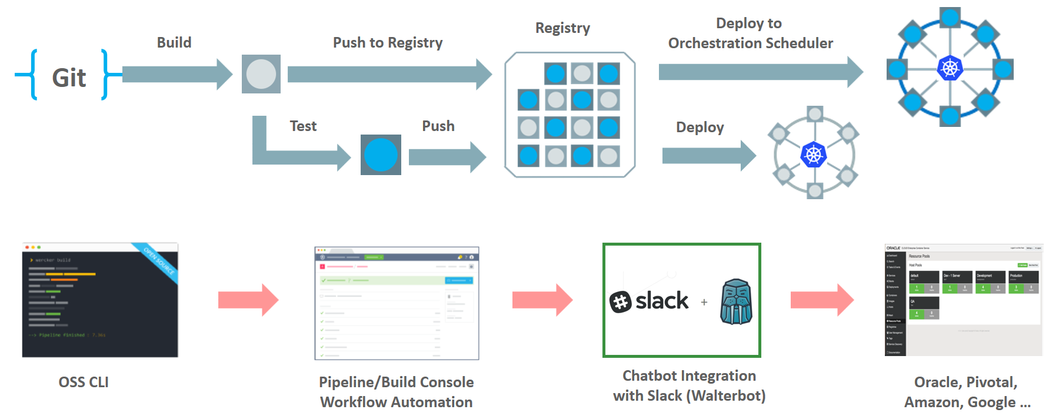
Wercker: Build, Test, Push and Deploy Pipelines for Containers
µ
µ
µ

Slide 16
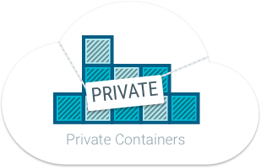
Where is the container image stored after build – prior to deploy?
Somewhere in a registry
That is secure (because runtime artefacts)
Low latency to container runtime
Scalable
Smart (no duplicate images and image layers)

Slide 17
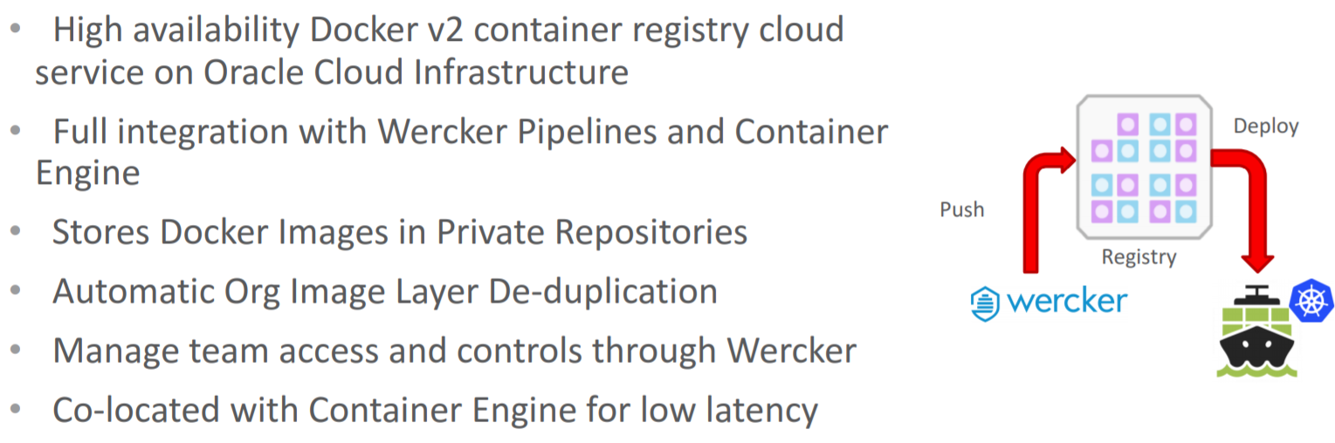
New component in container native platform: Oracle Container Registry Cloud Service
µ

Slide 18
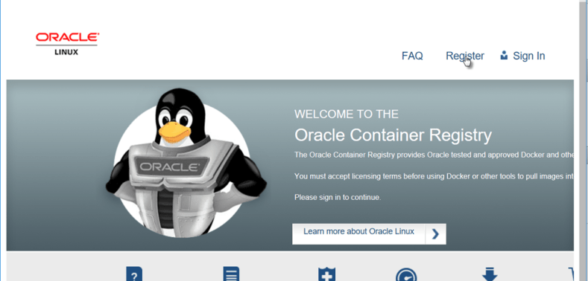
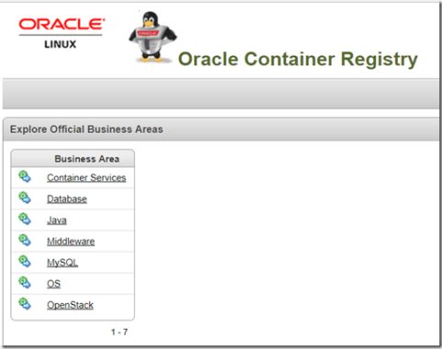
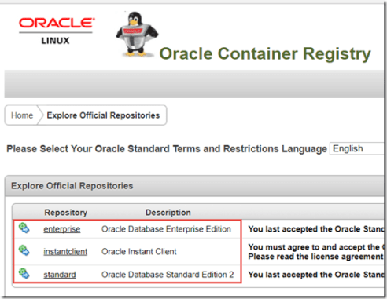

Slide 19
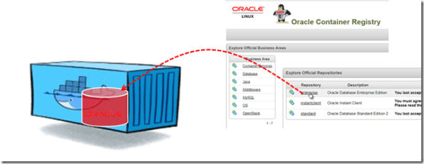
docker run -d -it –-name ORA12201_1 –P container-registry.oracle.com/database/enterprise:12.2.0.1
Notes:
https://technology.amis.nl/2017/11/18/run-oracle-database-in-docker-using-prebaked-image-from-oracle-container-registry-a-two-minute-guide/

Slide 20
How is availability - scaling, patching, fail-over, load balancing – taken care of?
Mapping of distributed physical resources to microservices and containers
Container Management Platform
Does deployment, scaling, (rolling) upgrades
Also load balancing and routing
Injection of run time settings
Kubernetes!

Slide 21
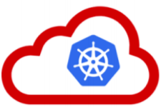
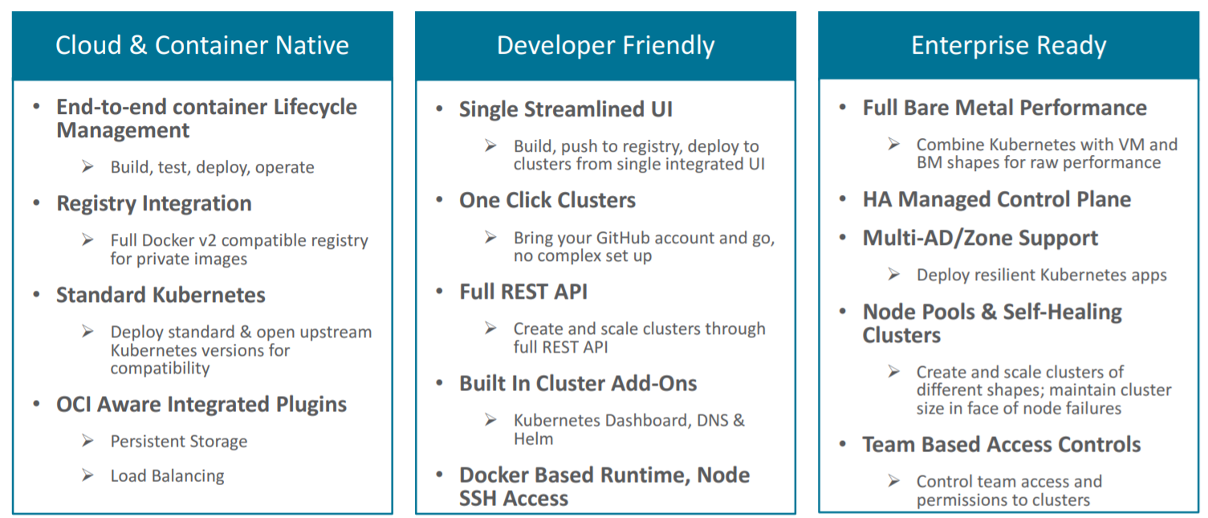
Oracle Container Engine Cloud == Managed Kubernetes Service

Slide 22
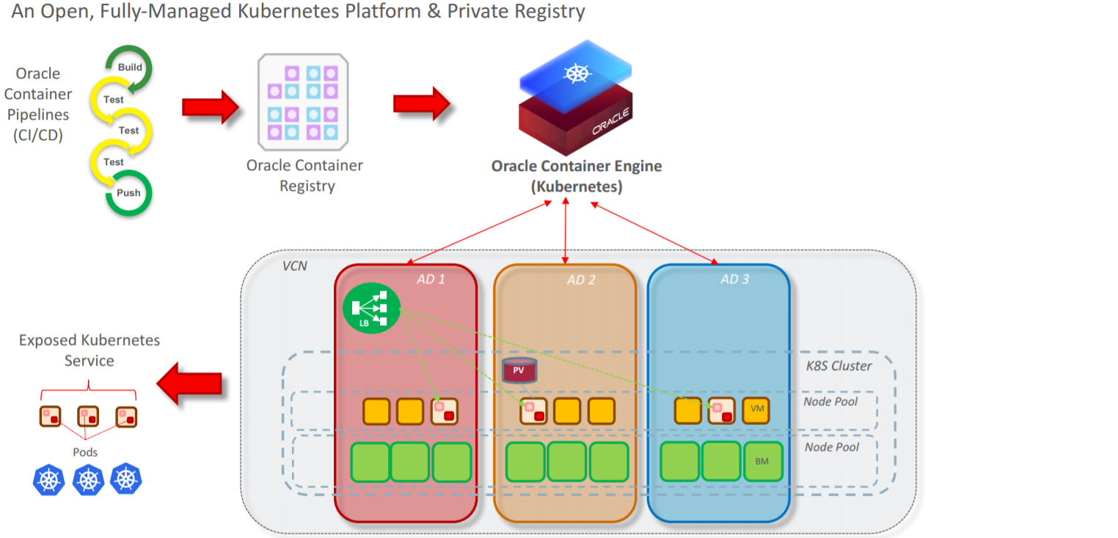
Container Registry, CI/CD Pipelines and Engine
µ
µ
µ
µ
µ

Slide 23
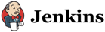


Container Native Microservices Runtime Platform
µ
Developer Cloud
Foo2
ISTIO
API Registry
Event Management
Open Service Broker
Managed Kubernetes
Cache
Voice Recognition
Block Storage
RDBMS
LDAP/IdM
NoSQL
Billing Engine

Slide 24
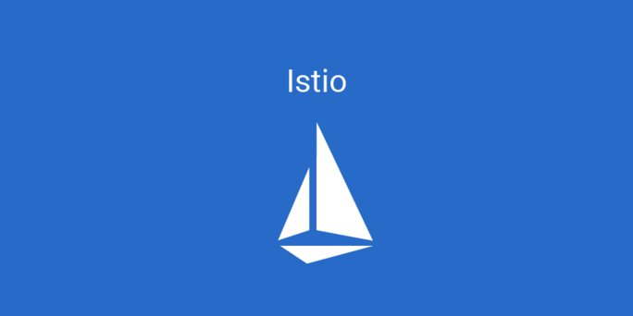
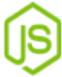
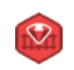
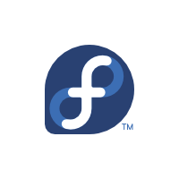
Operations for container native runtime platform From ‘service mess’ to Service Mesh
Support insight in and control over [micro]service interaction
Service discovery, intelligent routing, staged rollouts
Load balancing, rate limiting, circuit breaker, time out & retries
Access policies, auditing
Monitoring & error analysis
µ
µ
µ
µ
µ
µ
µ
API Registry
Event Management
Open Service Broker

Slide 25

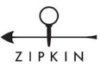

Oracle Container Native Microservices Architecture
µ
Foo2
Voice Recognition
API Registry
Event Management
Open Service Broker
Billing Engine
ISTIO
Diagnostics/Monitoring
Prometheus
Developer Cloud
ISTIO
ISTIO
Managed Kubernetes
Block Storage
Cache
RDBMS
LDAP/IdM
NoSQL

Slide 26
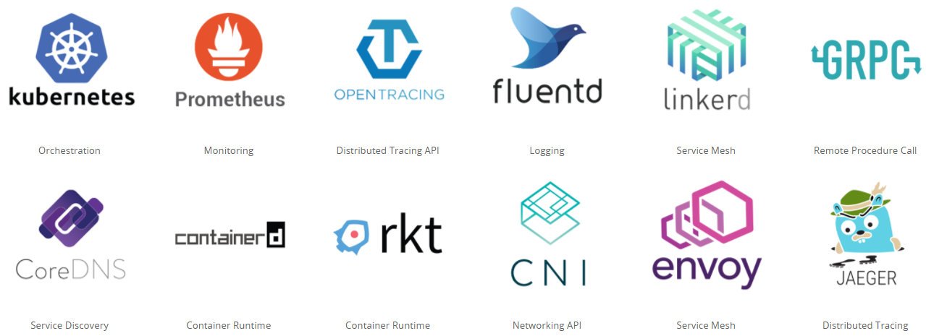
Cloud Native & Vendor Neutral
Cloud Native Computing Foundation - CNCF
Oracle is a platinum member since July 2017
Cloud Native: container packaged, dynamically managed, microservices oriented
Open technology for running container based workloads in a cross cloud vendor neutral way
Notes:
https://www.cncf.io/

Slide 27
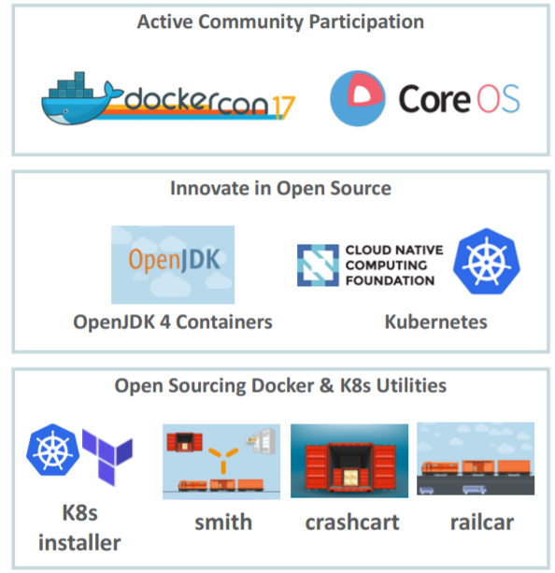
“Carry water and chop wood” (that is how Oracle will approach open source projects and developer communities)

Slide 28
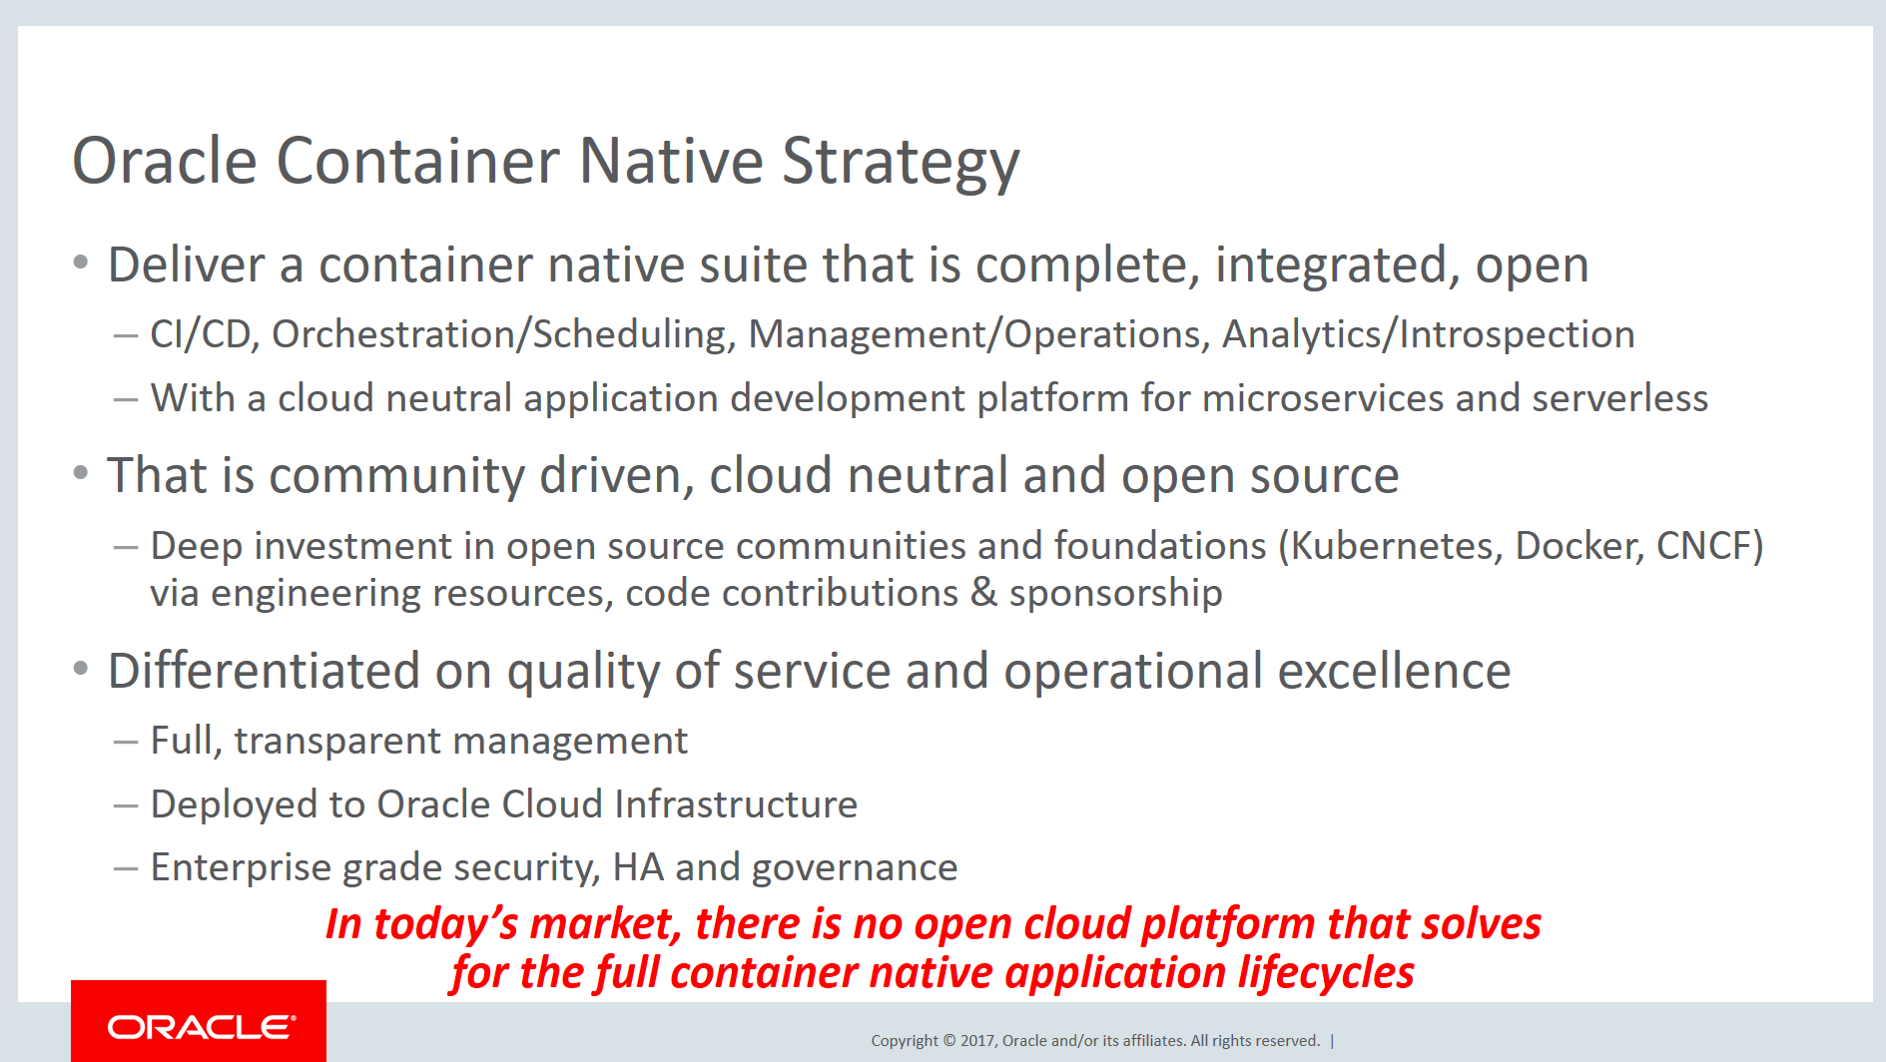
Container Native at Oracle - Low PaaS

Slide 29
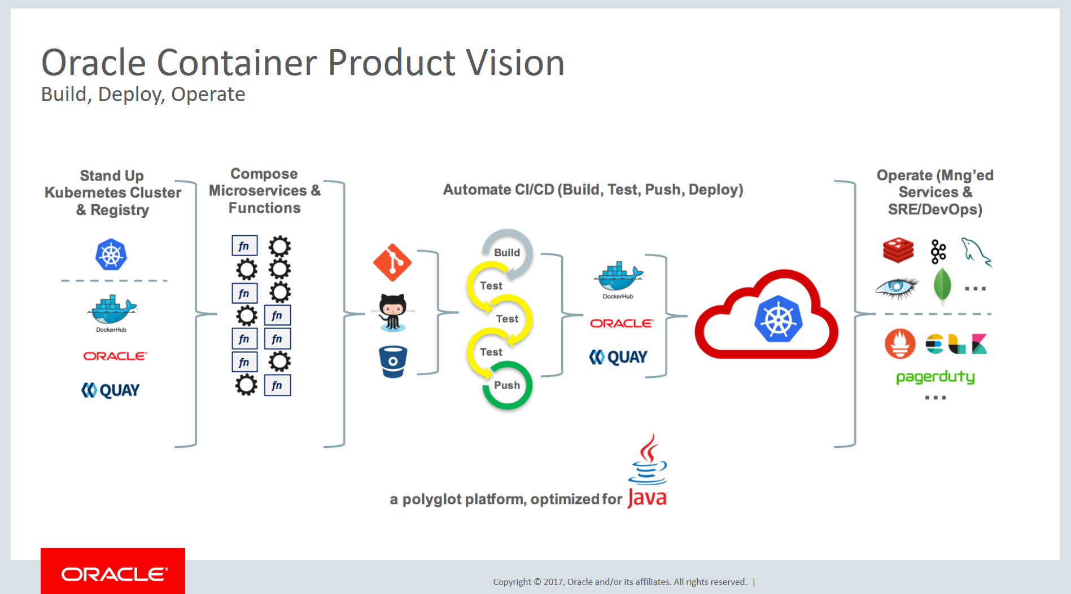
Stack for Full Life Cycle of Containers (and Microservices)

Slide 30
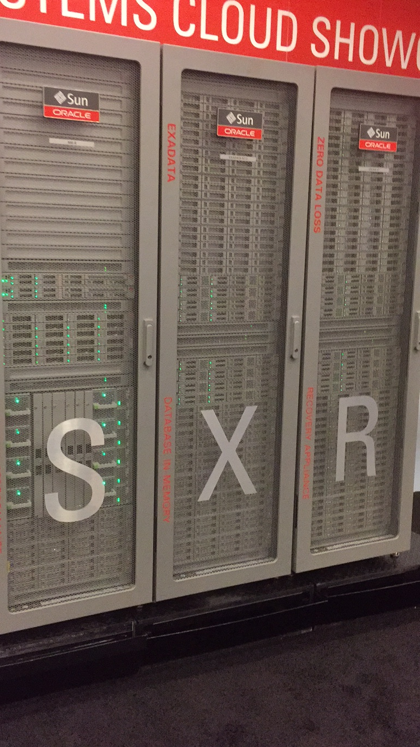
Serverless
λ
λ
λ
λ
λ
λ
λ
λ
λ
λ
λ
µ

Slide 31
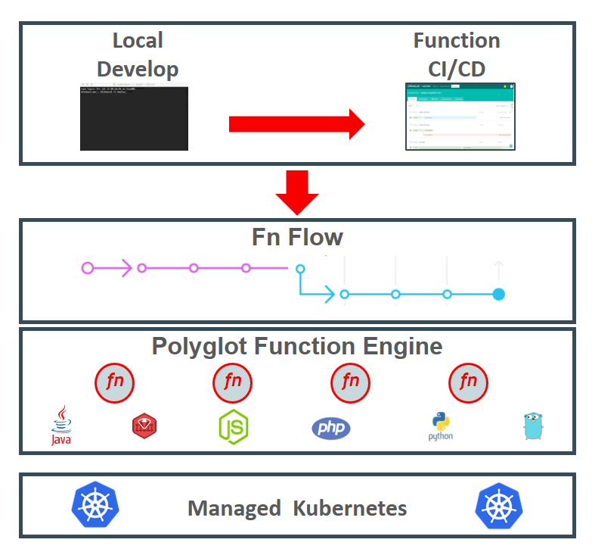
Open Source Serverless Function Platform
Functions can be implemented in any language
Java, Go, PHP, JavaScript/Node, Python, Ruby
Functions run in their own container
Functions can be accessed via HTTP calls
Routing, load balancing, running is taken care of by Fn Server platform
Platform runs locally, on prem & in cloud
Fn Flow orchestrates workflows across multiple functions
Workflow described in Java
Includes business logic (conditional, parallel execution, exceptions)
µ

Slide 32
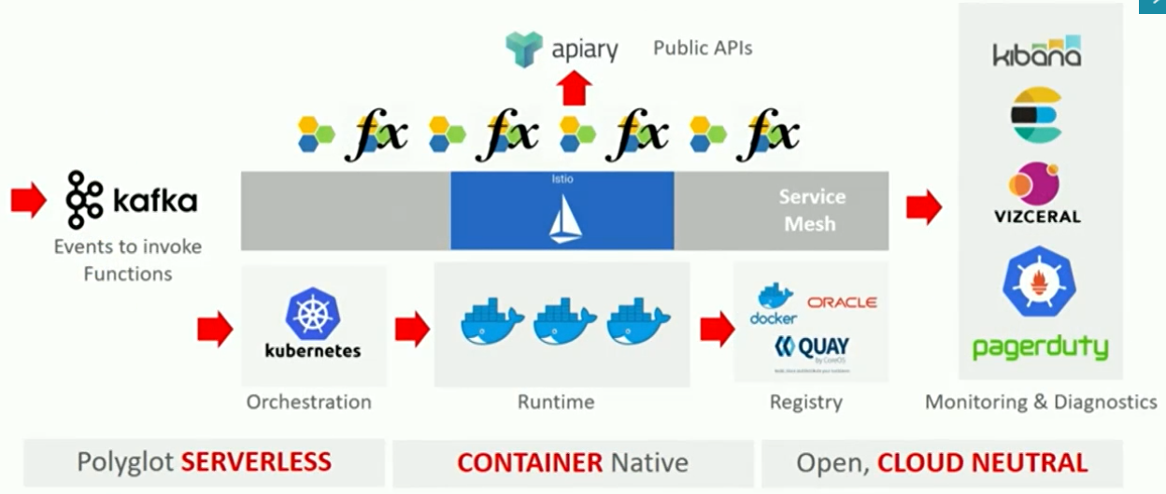
Managed Serverless Platform on Oracle Public Cloud
λ
µ

Slide 33
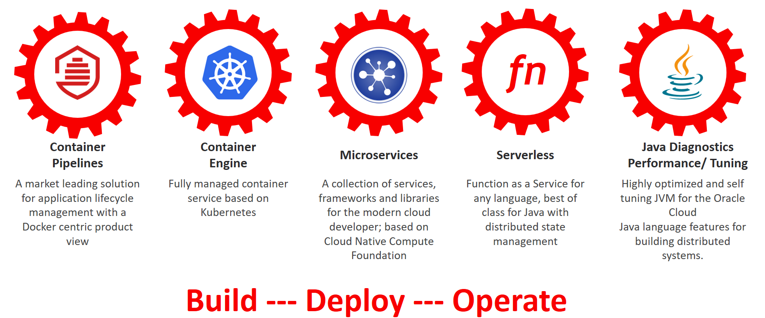
The application platform foundation of tomorrow – according to Oracle

